Slide 1
Data Structures & Algorithms (DSE2101)

Slide 2
Course Outcomes
After completion of this course student will be able to:
DSE 2101.1 : Understand the performance analysis of algorithms with their applications.
DSE 2101.2 : Illustrate basic concept of data structure operations such as traversing, insertion, deletion, searching and sorting.
DSE 2101.3 : Describe arrays, linked lists, stacks, queues, trees, and graphs are their representation in memory.
DSE 2101.4 : Perform various operations on different data structures and to solve real time problems.
DSE 2101.5 : Analyse and compare various searching and sorting algorithms, and assess the trade-offs involved in the design choices to develop employability skills.

Slide 3

Introduction: Algorithm Specification; Performance Analysis: Time and Space Complexity, Asymptotic Notation; C Concepts: Pointers, Functions, Arrays, Passing Arrays to Functions through Pointers, Dynamic Memory Allocation, Bubble Sort, Insertion Sort, Selection Sort, Structures, Arrays of Structures, Passing Structures to Functions; List: ADT, Array and its Types, Implementation, Operations, Linked List and its Types, Implementation and Operations; Stack: ADT, Implementations using Array and Linked List, Operations and its Applications; Queue: ADT, Implementations using Array and Linked List, Operations and its Applications; Tree: Terminologies, Different Types, Representation of Binary Tree using Array and Linked Structure, Binary Search Tree, Different Operations (Recursive and Non-Recursive), Heap, Heap Sort, Priority Queue, AVL Trees, B-Tree; Graph: Introduction, Representation, Operations and Applications; Searching Techniques And Hashing.

Slide 4

Textbooks:
1. Aaron M. Tenenbaum, Yedidyah Langsam, Moshe J. Augenstein, “Data Structures using C”, Pearson Education, 2013.
References Books:
1.Ellis Horowitz, Sartaj Sahni and Susan Anderson-Freed, “Fundamentals of Data Structures in C”, University Press (India) Pvt. Ltd., 2014.
2. Alfred V. Aho, John E. Hopcroft and Jeffrey D. Ullman, “Data Structures and Algorithms”, Pearson Education, 2012.
3. Thomas H. Cormen, Charles E. Leiserson, Ronald L. Rivest and Clifford Stein, “Introduction to algorithms”, PHI, Fourth Edition, 2022.
4. Seymour Lipschutz, “Data Structures with C (Schaum's Outline Series)”, McGraw Hill Education Private Limited, 2011.
5. Mark Allen Weiss, “Data structures and Algorithm Analysis in C”, Pearson, Second edition, 2014.

Slide 5
Let’s dive in

Slide 6
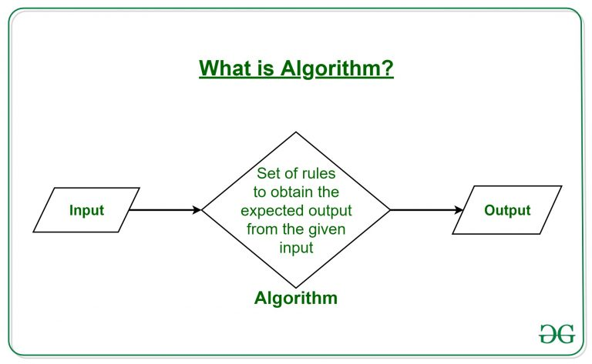
Algorithm - Introduction
A process or set of rules to be followed in calculations or other problem-solving operations.
Algorithm refers to a set of rules/instructions that step-by-step define how a work is to be executed upon in order to get the expected results.

Slide 7
Algorithm Design
An algorithm is the best way to represent the solution of a particular problem in a very simple and efficient way.
If we have an algorithm for a specific problem, then we can implement it in any programming language, meaning that the algorithm is independent from any programming languages.
The important aspects of algorithm design include creating an efficient algorithm to solve a problem in an efficient way using minimum time and space.

Slide 8
Characteristics of Algorithms
Not all procedures can be called an algorithm. An algorithm should have the following characteristics −
Unambiguous − Algorithm should be clear and unambiguous. Each of its steps (or phases), and their inputs/outputs should be clear and must lead to only one meaning.
Input − An algorithm should have 0 or more well-defined inputs.
Output − An algorithm should have 1 or more well-defined outputs, and should match the desired output.
Finiteness − Algorithms must terminate after a finite number of steps.
Feasibility − Should be feasible with the available resources.
Independent − An algorithm should have step-by-step directions, which should be independent of any programming code.

Slide 9
Describing Algorithms
Algorithms can be implemented in any programming language
Usually we use “pseudo-code” to describe algorithms
Testing whether input N is prime:
For j = 2 .. N-1
If j|N
Output “N is composite” and halt
Output “N is prime”

Slide 10
What is the specification of algorithm?
We can specify an algorithm by 3 types:
1. Using Natural language
2. Pseudocode;
3. And flowchart.
Natural language is general way to solve any problem
For e.g to perform addition of two numbers we write in natural language
Step1: read the first number (assume a)
Step2:read the second number (assume b)
Step3:add 2 numbers(a and b)and store the result in a variable c
Step4:display the result

Slide 11
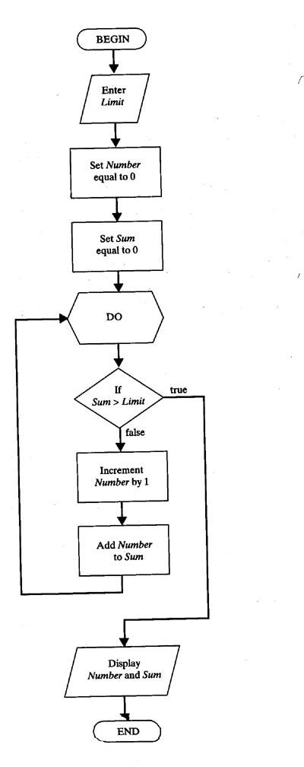
A way to represent an algo is Flow chart .

Slide 12
Difference between Algorithm and Pseudocode
Algorithm | Pseudocode
An algorithm is a formal definition with some specific characteristics that describes a process, which could be executed by a computer machine to perform a specific task. | Pseudocode is an informal human readable description of an algorithm leaving many granular details of it. Writing a pseudocode has no restriction of styles.
Algorithm: Insertion-Sort Input: A list L of integers of length n Output: A sorted list L1 containing those integers present in L Step 1: Keep a sorted list L1 which starts off empty Step 2: Perform Step 3 for each element in the original list L Step 3: Insert it into the correct position in the sorted list L1. Step 4: Return the sorted list Step 5: Stop | for i <- 1 to length(A) x <- A[i] j <- i while j > 0 and A[j-1] > x A[j] <- A[j-1] j <- j - 1 A[j] <- x

Slide 13
Pseudo Code
Expressions: use standard mathematical symbols
use ← for assignment ( ? in C/C++)
use = for the equality relationship (? in C/C++)
Method Declarations: -Algorithm name(param1, param2)
Programming Constructs:
decision structures: if ... then ... [else ..]
while-loops while ... do
repeat-loops: repeat ... until ...
for-loop: for ... do
array indexing: A[i]
Methods
calls: object method(args)
returns: return value
Use comments
Instructions have to be basic enough and feasible!

Slide 14
What is a program?
A program is the expression of an algorithm in a programming language
a set of instructions which the computer will follow to solve a problem

Slide 15
Algorithm Paradigms
Different people think differently, so they have different style and approach towards solving a problem.
There are various ways available to solve a single problem.
So algorithm can be of different types .
According to:
Based on implementation
Based on complexity
Based on design paradigm

Slide 16
Based on implementation and complexity
An algorithm serves only the purpose of describing how to solve a problem.
But in order to solve a problem actually it needs to be implemented or converted into a program. An implementation can be:
Iteration vs recursion
Serial vs parallel
Deterministic vs non deterministic
Exact vs approximate

Slide 17
Questions?

